Slide 1
Azure Cosmos DB Administration
Module 2

Slide 3
Learning Units covered in this Module
Lesson 1: Throughput
Lesson 2: Autopilot
Lesson 3: Partitioning
Lesson 4: Global Distribution and Consistency
Lesson 5: Indexing
Lesson 6: Security and Compliance
Lesson 7: Migration

Slide 4
Lesson 1: Throughput

Slide 5

Objectives
After completing this learning, you will be able to:
Understand Request Units (RU) and monitoring RU consumption
Understand reserved capacity
Understand the pricing
Learn how to run capacity calculator

Slide 6
Request Units (RUs)
Throuput Currency
Abstracts physical resources for predictable performance
1 RU = processing required to read a 1 KB item
Reserved amount of guaranteed request units
Specify RU/second for each collection
Notes:
https://docs.microsoft.com/en-us/azure/cosmos-db/request-units
RUs are managed and scalable at the container level
Operating hundreds of thousands of globally distributed and diverse workloads cost-effectively requires fine-grained multi-tenancy, where hundreds of customers share the same machine and yet thousands share the same cluster. To provide performance isolation to each customer while operating cost-effectively, we’ve engineered the entire system from the ground up with resource governance in mind. As a resource governed system, Azure Cosmos DB is a massively distributed queuing system with cascaded stages of components, each carefully calibrated to deliver predictable throughput while operating within the allotted budget of system resources

Slide 7
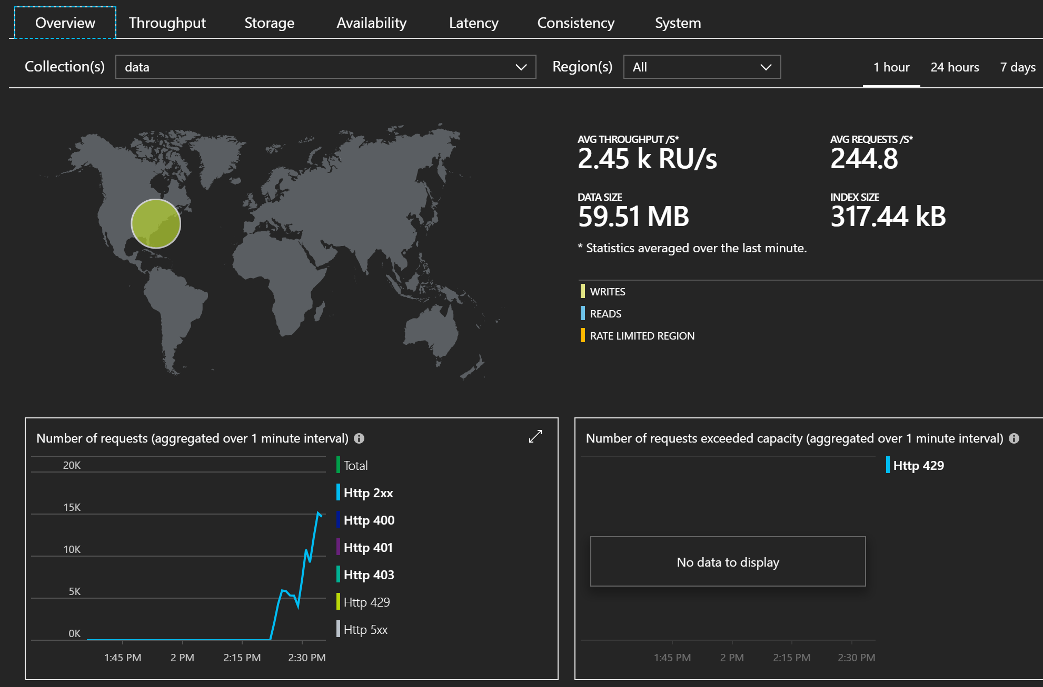
Monitoring Request Units
Azure Portal metrics at account and collection level
Displays average RU/s over a specified time-span
Notes:
At a glance view of average throughput directly through the Azure Portal.

Slide 8
Request Units (Rus) Billing
Based on resources provisioned, not on actual usage
Monitor and manage RU/s to control costs
RU capacity is elastic and can be instantly scaled via Azure Portal or programmatically to match demand
Metered hourly
Notes:
It is important to note that billing charges are based on the resources reserved based on the container RU capacity. Billing is not based on usage. This is to ensure multi-tenant SLA guarantees. It is very easy to instantly scale resources through the RU abstraction.
Pricing:
https://azure.microsoft.com/en-us/pricing/details/cosmos-db/

Slide 9
Sample RU Calculations
Item size | Reads/s | Writes/s | Calculation | Request Units
1 KB | 500 | 100 | (500 * 1) + (100 * 5) | 1,000 RU/s
1 KB | 500 | 500 | (500 * 1) + (500 * 5) | 3,000 RU/s
4 KB | 500 | 100 | (500 * 1.3) + (100 * 7) | 1,350 RU/s
4 KB | 500 | 500 | (500 * 1.3) + (500 * 7) | 4,150 RU/s
64 KB | 500 | 100 | (500 * 10) + (100 * 48) | 9,800 RU/s
64 KB | 500 | 500 | (500 * 10) + (500 * 48) | 29,000 RU/s
Notes:
https://docs.microsoft.com/en-us/azure/cosmos-db/request-units#estimating-throughput-needs
-The standard “RU” is reading 1 KB of data. Therefore the calculation is 500 * 1 for the number of Request Units used. A write consumes roughly 5 RUs for a single 1KB read
-As the item size scales, the RUs consumed required to read and write an object does not scale 1:1. As you can see, the item sized has increased 4 times, but the RUs required to read only increased from 1 to 1.3.
-As the item size scales, the RUs consumed does not scale 1:1 with it. As you can see, the item sized has increased 64 times, but the RUs required to read only increased from 1 to 10. The costs to read and write increases with file size but does not grow directly.
Note that Request Units does not scale directly with Item size. Counter intuitively, efficiency increases as item size increases as the amount of overhead required to perform tasks is reduced relative to the size of the item.

Slide 10
Monitor RU Consumption
Azure Portal
Inspecting the response sent back from Azure Cosmos DB through one of the SDKs
Every response from Cosmos DB includes the RUs consumed during the operation
x-ms-request-charge” HTTP response header returns exactly how many RUs were consumed
Notes:
https://docs.microsoft.com/en-us/azure/cosmos-db/find-request-unit-charge
-Azure portal-DataExplorer: viewing query stats per execution requests
-Use several SDKs from link above.

Slide 11
Reserved Capacity
Helps you save money by committing to a reservation for Azure Cosmos DB resources for either one year or three years.
You can get a discount on the throughput provisioned for Cosmos DB resources. Examples of resources are databases and containers (tables, collections, and graphs).
Size of the reservation should be based on the total amount of throughput that the existing or soon-to-be-deployed Azure Cosmos DB resources will use
Notes:
Reserved Capacity:
https://docs.microsoft.com/en-us/azure/cosmos-db/cosmos-db-reserved-capacity
You can buy Azure Cosmos DB reserved capacity from the Azure portal. Pay for the reservation up front or with monthly payments. To buy reserved capacity:
-You must be in the Owner role for at least one Enterprise or individual subscription with pay-as-you-go rates.
-For Enterprise subscriptions, Add Reserved Instances must be enabled in the EA portal. Or, if that setting is disabled, you must be an EA Admin on the subscription.
-For the Cloud Solution Provider (CSP) program, only admin agents or sales agents can buy Azure Cosmos DB reserved capacity.

Slide 12
Pricing Model
Provisioned Throughput
Guarantees high performance at any scale.
You specify the throughput (RU/s) that you need, and Azure Cosmos DB dedicates the resources required to guarantee the configured throughput.
Billed hourly for the maximum provisioned throughput for a given hour.
Consumed Storage
Billed a flat rate for total amount of storage (GBs) consumed for data and indexes for a given hour.
Multi-Region
can add and remove regions to your Azure Cosmos account at any time
Throughput that you configure for various Azure Cosmos databases and containers is reserved in each region associated with your account
Notes:
https://docs.microsoft.com/en-us/azure/cosmos-db/how-pricing-works

Slide 13
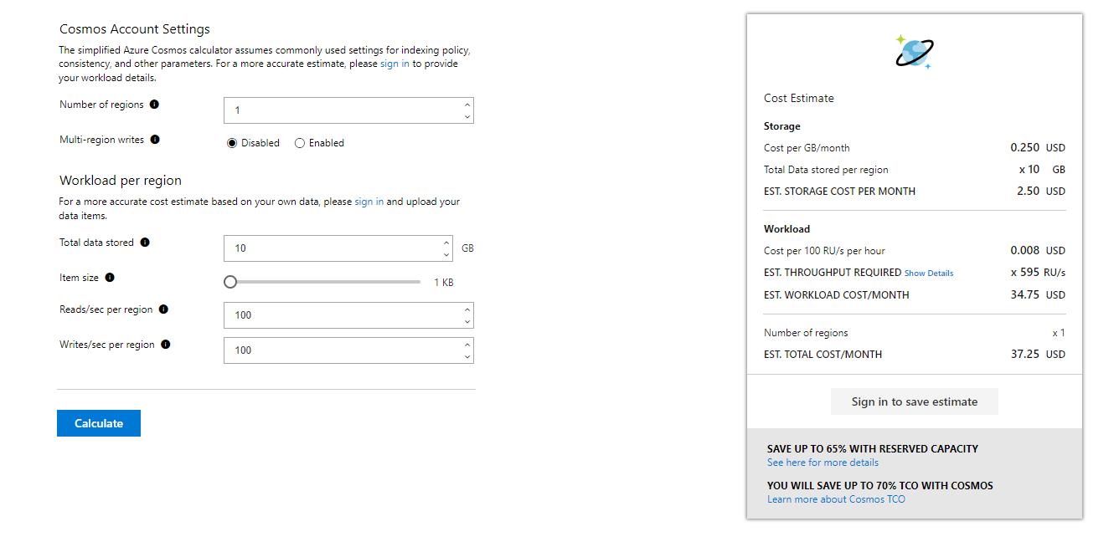
Capacity Calculator
Cosmos DB capacity planner calculator
https://cosmos.azure.com/capacitycalculator/
Notes:
https://www.documentdb.com/capacityplanner
https://docs.microsoft.com/en-us/azure/cosmos-db/request-units#estimating-throughput-needs

Slide 14

Demonstration
View RU Values through Azure Portal-Data Explorer
Notes:
Consider demoing the following:
-Open up “View RU Values through Azure Portal-Data Explorer document” under lab folder.
Run the example queries in document to show customer how you can view RU values per query execution using Data Explorer in Azure Portal.

Slide 15

View Request Charges
Open view request charges header in Visual Studio
Notes:
Link to lab:
##########
Help students complete the lab View Request Charges

Slide 16
Knowledge Check
True or false. Billing is based on computational usage; you only pay for what you use?
What response header includes the number of RUs consumed for a given request?
What are the three pricing models?
Notes:
True or false. Billing is based on computational usage, you only pay for what you use.
False, billing is based on allocated resources. You pay for what you reserve (RUs reserved) With Azure Cosmos DB, you pay for the throughput you provision and the storage you consume on an hourly basis.
What response header includes the number of RUs consumed for a given request?
“x-ms-request-charge”
What are the three pricing models?
Provisioned throughput
consumed storage
Multi-Region

Slide 17

Questions?

Slide 18
Lesson 2: Autopilot

Slide 19
Objectives
After completing this learning, you will be able to:
Understand how Azure Cosmos DB will automatically manage and scale the RU/s of your containers based on the usage

Slide 21
Demonstration
Notes:
Consider demoing the following:
-
##########

Slide 22
Notes:
Link to lab:
##########

Slide 23
Questions?

Slide 24
Knowledge Check
<Question 1>
<Question 2>
<Question 3>
<Question 4>
<Question 5>
<Question 6>

Slide 25
Lesson 3: Partitioning

Slide 26
Objectives
After completing this learning, you will be able to:
Understand the partitioning in Cosmos DB
Practice on choosing and changing partitioning key

Slide 28
Demonstration
Notes:
Consider demoing the following:
-
##########

Slide 29
Notes:
Link to lab:
##########

Slide 30
Questions?

Slide 31
Knowledge Check
<Question 1>
<Question 2>
<Question 3>
<Question 4>
<Question 5>
<Question 6>

Slide 32
Lesson 4: Global Distribution and Consistency

Slide 33
Objectives
After completing this learning, you will be able to:
Understand data replication and disaster recovery
Understand how to enable turnkey global distribution and multi master
Learn different consistency options

Slide 35
Demonstration
Notes:
Consider demoing the following:
-Query data using Data Explorer in azure portal and view Request Charge values per query under Query Stats.
##########

Slide 36
Notes:
Link to lab:
##########

Slide 37
Questions?

Slide 38
Knowledge Check
<Question 1>
<Question 2>
<Question 3>
<Question 4>
<Question 5>
<Question 6>

Slide 39
Lesson 5: Indexing

Slide 40
Objectives
After completing this learning, you will be able to:
Understand indexing policy and modes
Learn how to modify the indexing policy
Learn composite indexes

Slide 41
Schema-agnostic, automatic indexing
Automatically index every property of every record
No need for schema and index management
Latch-free data structure for write-optimized engine
Multiple index types: hash, range, geospatial
Notes:
At global scale, schema/index management is hard
Automatic and synchronous indexing of all ingested content - hash, range, geo-spatial, and columnar
No need to define schemas or secondary indices upfront
Resource governed, write optimized database engine with latch free and log structured techniques
Online and in-situ index transformations

Slide 42
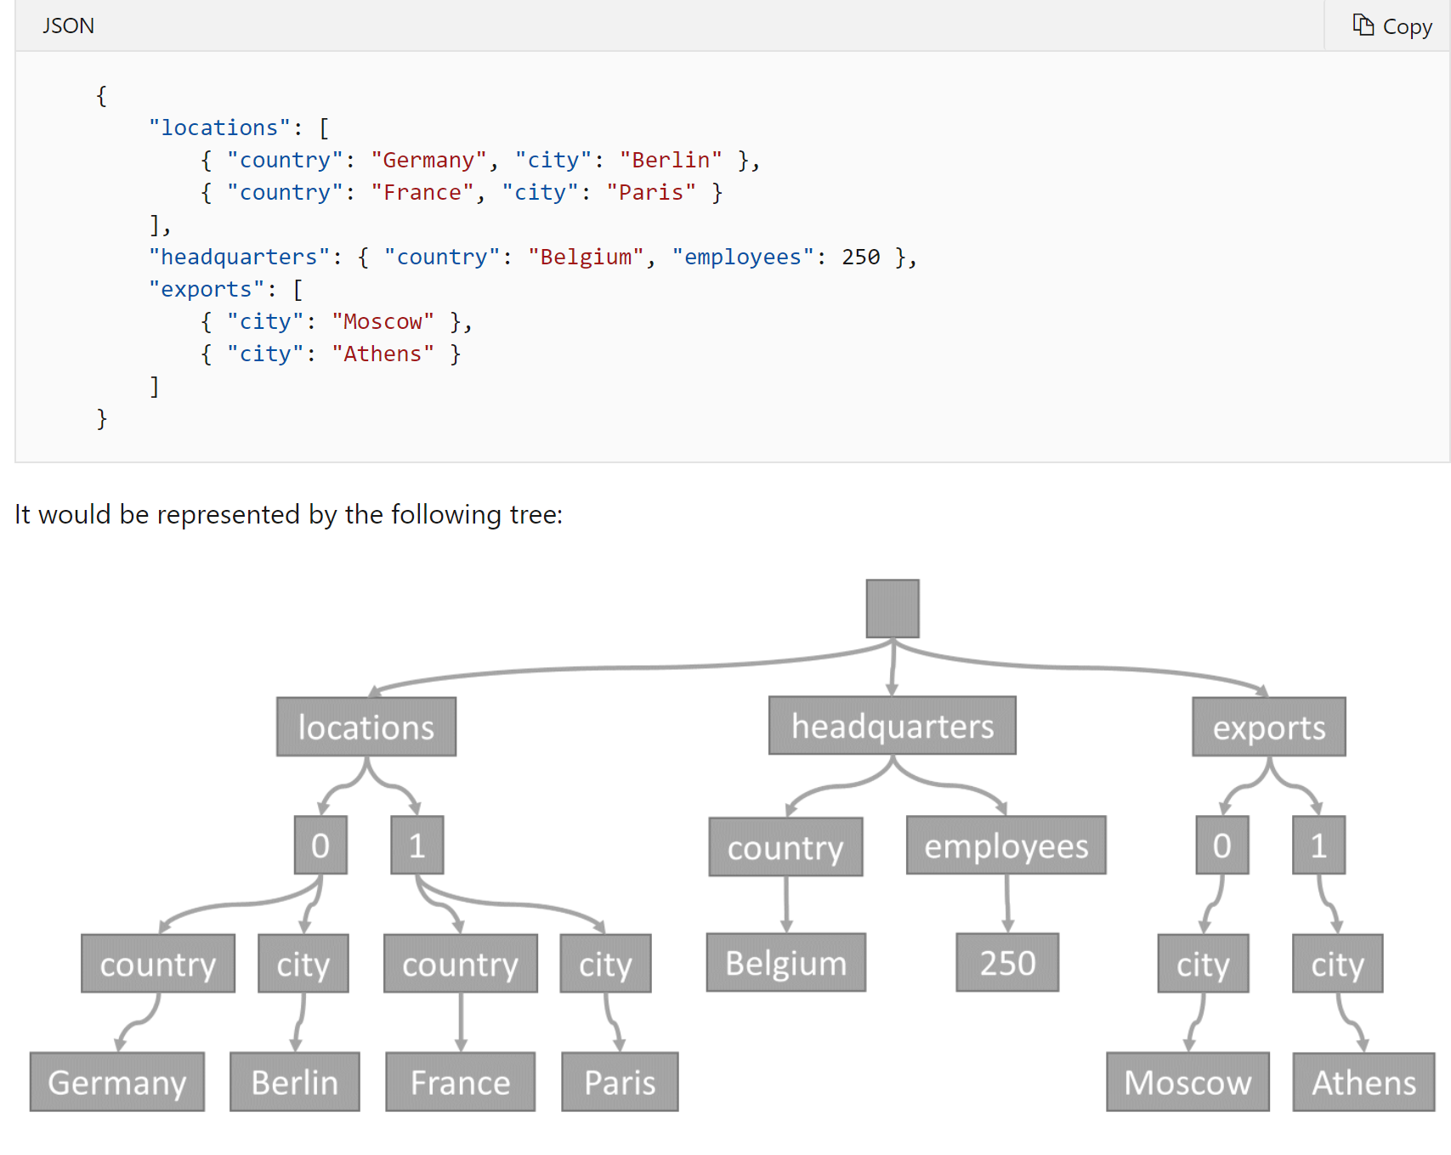
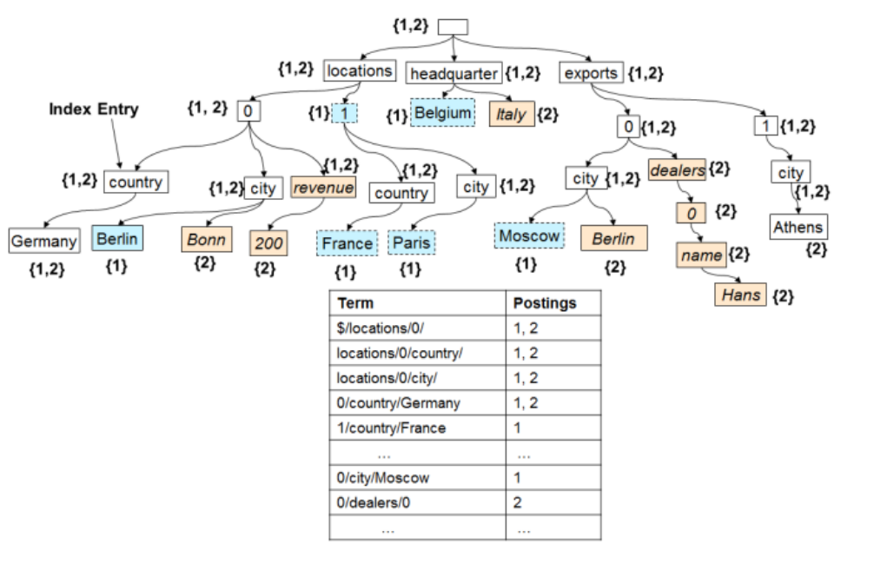
Indexing – Under the Hood
JSON documents can be represented as hierarchical trees
Merge multiple documents to create an inverted index
Notes:
The root node represents the root document.
Each child node is one level deeper into the properties of the root document.
Each leaf node represents the instance values for the record
In an inverted index, you can use filters in queries to quickly find documents that contain target records.
For example: Find me all locations in the country of Germany.
Traverse the index tree to locations -> country -> Germany. And the leaf value will show that documents 1 and 2 have a location in the country of Germany.
This results in an index over every property of every record where each record does not have to have a shared schema

Slide 43
Inverted Index
Capable of indexing every property of every record
Does not require a defined schema
Records can have heterogeneous schema
Common property structure will result in most efficient indexing structure

Slide 44
Indexing Modes
Consistent
Index updates synchronously with document updates
“Write quickly, query immediately
Lazy
Index updates asynchronously when throughput is not utilized
“Ingest now,
query later”
None
No indexing, queries are scan only
“Cosmos DB as a key-value store”
Notes:
Set at the collection level
Consistent: If an Azure Cosmos DB collection’s policy is Consistent, the queries on a specific Azure Cosmos DB collection follow the same consistency level as specified for the point-reads (strong, bounded-staleness, session, or eventual). Consistent indexing supports consistent queries at the cost of a possible reduction in write throughput. This reduction is a function of the unique paths that need to be indexed and the “consistency level.”
Lazy: Cosmos DB also supports a Lazy indexing mode. Lazy indexing performs updates to the index at a much lower priority level when the engine is not doing any other work. This can result in inconsistent or incomplete query results.
None: A collection that has a None index mode has no index associated with it. This is commonly used if Azure Cosmos DB is used as a key-value storage, and documents are accessed only by their ID property.

Slide 45
Index Policies - Tuning Indices
Fine tune indexing policies via SDKs or the Azure Portal
Shape indexing policies without affecting schema
Make trade-offs between index overhead, write and query throughput, and query consistency
Notes:
https://docs.microsoft.com/en-us/azure/cosmos-db/index-policy

Slide 46
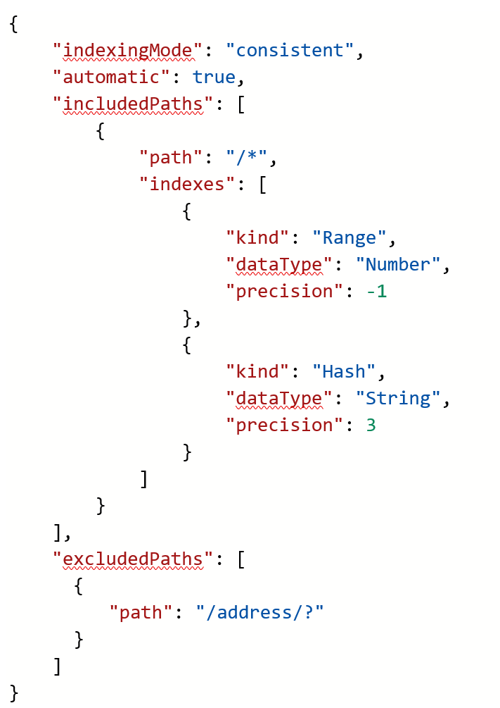
Simple Indexing Policy
Index policies are set per path
Paths can contain wildcards
Policies are determined by most specific paths
Included vs excluded paths
Notes:
https://docs.microsoft.com/en-us/azure/cosmos-db/index-policy

Slide 47
Index Paths
/
Default path for collection. Recursive and applies to the entire document tree.
/prop/?
Index path required to serve queries at this level
SELECT FROM collection c WHERE c.prop = "value“
SELECT FROM collection c WHERE c.prop > 5
SELECT FROM collection c ORDER BY c.prop
/prop/*
Index path for all paths under the specified label.
SELECT FROM collection c WHERE c.prop.subprop > 5
SELECT FROM collection c WHERE c.prop.subprop.nextprop = "value“
/props/[]/?
/prop/subprop/?
SELECT FROM collection c WHERE c.prop = "value"
Serve iteration and JOIN queries against scalar arrays
SELECT tag FROM tag IN collection.props WHERE tag = "value"
SELECT tag FROM collection c JOIN tag IN c.props WHERE tag > 5
Index path required to serve queries
SELECT FROM collection c WHERE c.prop.subprop = "value"
SELECT FROM collection c WHERE c.prop.subprop > 5
Notes:
Azure Cosmos DB models JSON documents and the index as trees. You can tune to policies for paths within the tree. Within documents, you can choose the paths to include or exclude from indexing. This can offer improved write performance and lower index storage for scenarios in which the query patterns are known beforehand.
Index paths start with the root (/) and typically end with the ? wildcard operator. This denotes that there are multiple possible values for the prefix. For example, to serve SELECT * FROM Families F WHERE F.familyName = "Andersen", you must include an index path for /familyName/? in the collection’s index policy.
Index paths can also use the * wildcard operator to specify the behavior for paths recursively under the prefix. For example, /payload/* can be used to exclude everything under the payload property from indexing.

Slide 48
Including & Excluding Property Paths
/? : a path leading to a scalar value (string or number) ends with the notation.
/[] : elements from an array are addressed together through this notation. Instead of /0/1,etc.
/* : wildcard can be used to match any elements below the node
No Indexing : Will turn off indexing
Notes:
A custom indexing policy can specify property paths that are explicitly included or excluded from indexing. By optimizing the number of paths that are indexed, you can lower the amount of storage used by your container and improve the latency of write operations. These paths are defined following the method described in the indexing overview section with the following additions:
Excluding all property paths:
This policy can be used in situations where the Time-to-Live (TTL) feature is active but no secondary index is required (to use Azure Cosmos DB as a pure key-value store).
No Indexing:
This policy will turn off indexing. If IndexingMode is set to none, you cannot set a TTL on the container.
https://docs.microsoft.com/en-us/azure/cosmos-db/index-policy

Slide 49
Composite Indexes
{
"automatic“ : true,
"indexingMode“ : "Consistent” ,
"includedPaths“ :[
{
"path“ : "/*"
}
],
"excludedPaths“ :[],
"compositeIndexes“ :[
[
{
"path“ : "/name“ ,
"order“ : "ascending"
},
{
"path“ : "/age",
"order“ : "descending"
}
]
]
}
ORDER BY queries on multiple properties
Queries with a filter as well as an ORDER BY clause
Queries with a filter on two or more properties
Notes:
By default, Azure Cosmos DB will create a range index on every property. For many workloads, these indexes are enough, and no further optimizations are necessary.
Composite indexes can be added in addition to the default range indexes. Composite indexes have both a path and order (ASC or DESC) defined for each property within the composite index.
Composite indexes will have a performance benefit for queries that have a filter and have an ORDER BY clause on different properties.
Example:
SELECT *
FROM c
ORDER BY c.name DESC, c.age ASC

Slide 50
Modifying Index Policy
Policy can be updated using:
from the Azure portal
using the Azure CLI
using PowerShell
using one of the SDKs
Performed online and in place, no downtime
Performed asynchronously
Changes made in place, no additional storage consumed
Notes:
https://docs.microsoft.com/en-us/azure/cosmos-db/indexing-policies#modify-the-indexing-policy-of-a-collection
Changes are applied to move from the old index to the new primarily based on the indexing mode configurations. Indexing mode configurations play a larger role than other values like included/excluded paths, index kinds, and precisions.
If your old and new policies both use Consistent indexing, Azure Cosmos DB performs an online index transformation. You can't apply another indexing policy change that has Consistent indexing mode while the transformation is in progress. However, you can move to Lazy or None indexing mode while a transformation is in progress:
When you move to Lazy, the index policy change is effective immediately. Azure Cosmos DB starts re-creating the index asynchronously.
When you move to None, the index is dropped immediately. Moving to None is useful when you want to cancel an in-progress transformation, and start fresh with a different indexing policy.

Slide 51
Demonstration
Viewing& Modifying Index Policies using Azure Portal-Data Explorer
Notes:
Consider demoing the following:
Open the Viewing and managing index policy document
- Show customer how you can modify index policies using the Azure Portal. Document contains the detail info in steps.

Slide 52
Explore Index Policies
Exploring indexing policies in Visual Studio
Notes:
Link to lab:
##########
Walk through the lab as a class.
Complete the lab with the students. Students should complete the lab on their machines along with you. Go through the lab manual steps and the comments in the C# program to teach students how indexing policies can be set and used programmatically.

Slide 53
Knowledge Check
What are the three index kinds?
What are the three indexing modes?
Policies can be updated using?
Notes:
What are the three index kinds?
Hash, Range, Spatial
What are the three indexing modes?
Consistent, eventual, none
Policies can be updated using?
the Azure portal
Azure CLI
PowerShell
using one of the SDKs

Slide 54
Questions?

Slide 55
Lesson 6: Security and Compliance

Slide 56
Objectives
After completing this learning, you will be able to:
Understand how to secure your database

Slide 58
Demonstration
Notes:
Consider demoing the following:
-
##########

Slide 59
Notes:
Link to lab:
##########

Slide 60
Questions?

Slide 61
Knowledge Check
<Question 1>
<Question 2>
<Question 3>
<Question 4>
<Question 5>
<Question 6>

Slide 62
Lesson 7: Migration

Slide 63
Objectives
After completing this learning, you will be able to:
Understand the migration steps
Learn migration tools for SQL API

Slide 65
Demonstration
Notes:
Consider demoing the following:
-
##########

Slide 66
Notes:
Link to lab:
##########

Slide 67
Questions?

Slide 68
Knowledge Check
<Question 1>
<Question 2>
<Question 3>
<Question 4>
<Question 5>
<Question 6>

